Slide 1
🖐️ Palmist

Slide 2
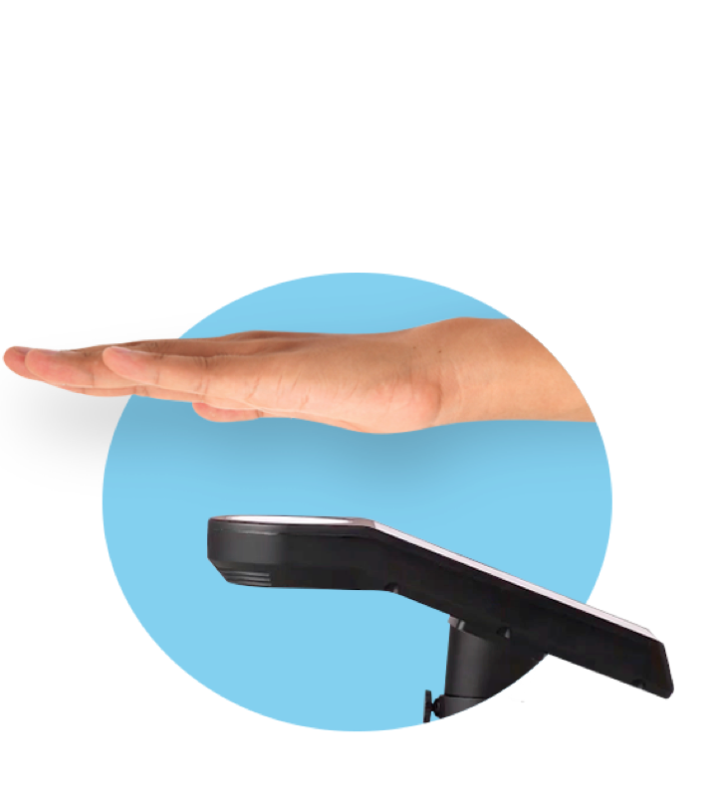
A
C
👥 Domain
register
👥 Domain
share?
👥 Domain
🖐️ Palmist
🆔 Biometric
🃏 Issuer
🖐️ scan palm
🛂 show passport
🔑 issue token
😶
issue
D
B
bind
🧑‍🦰 Wallet: App
🔑 store token
2
print
E
scan palm
scan
QR
👥 Domain
1
📄 Printed
🔎 Consumer
✨ QR Credential
Notes:
Biometrics: Uses and Abuses
https://www.schneier.com/essays/archives/1999/08/biometrics_uses_and.html
How does Pico work?
https://www.cl.cam.ac.uk/~fms27/pico/technical/

